Slide 1
Embedded System Laboratory
2020 Summer Training
Lecture 3: Timer & Interrupt
Made by 許家偉 2020/7

Slide 2
Outline
Introduction of Interrupt
Introduction of Timer
Exceptions in ARM_v8
Implementation

Slide 3
Introduction of Interrupt
What is “Interrupt”?
An event that requires the CPU to stop normal process execution and perform some service.
Usually generated by hardware (although they can be initiated by software).
Often indicate that an event has occurred that needs an urgent response.
Interrupts may occur at any time.
Notes:
需要CPU停下手邊正在做的事情 轉而去處理其他事件
硬/軟體可觸發
通常為必須馬上處理/回應的請求

Slide 4
Introduction of Interrupt
Before we have interrupts, the technique we used is:
Busy Waiting.(Polling)
- A process repeatedly checks to see if a condition is true.
But now we use interrupts.
In systems programming, an interrupt is a signal to the processor emitted by hardware or software indicating an event that needs immediate attention.
-Wikipedia, the savior of teaching assistants
Notes:
或者又叫 polling
可以由硬體或軟體來觸發
目的是處理必須馬上處理的事件

Slide 5


Introduction of Interrupt is interrupt
Busy waiting is just like…
The keypad
And it’s our CPU

Slide 6


Introduction of Interrupt
An interrupt is just like…
An emergency happened, Your Majesty
Ok, I’m going to handle it.

Slide 7
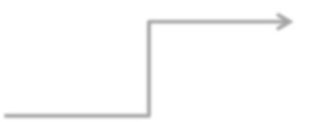

Introduction to Interrupt
When an interrupt occurs, the processor :
Save current status (reg. data, return address)
Goto interrupt service routine
Fininshed, back to original execution
main( ){
Interrupt service routine(ISR)
while(true){
Interrupt
program
}
Notes:
Low priority interrupts are not processed while high priority interrupts are in progress.

Slide 8
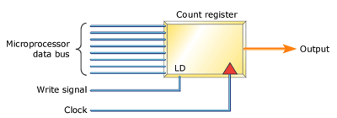
Introduction of Timer
The counter increases its value by 1 after each clock tick
When counter is equal to compare register, the interrupt occurs
Notes:
需要CPU停下手邊正在做的事情 轉而去處理其他事件
硬/軟體可觸發
通常為必須馬上處理/回應的請求

Slide 9
Exceptions in ARM_v8
4 types of exception
Synchronous exception
software interrupt , ex: store data at an unexistent memory location
IRQ (Interrupt Request)
Asynchronous interrupts , generated by external hardware
FIQ (Fast Interrupt Request)
Prioritizing IRQ
SError (System Error)
Indicates error condition generated by external hardware

Slide 10
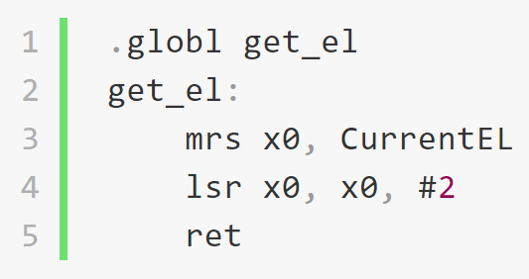
Exceptions in ARM_v8
4 exception levels
EL0
User process
EL1
Guest OS level
EL2
Host OS level
EL3
Hardware level
CurrentEL register

Slide 11
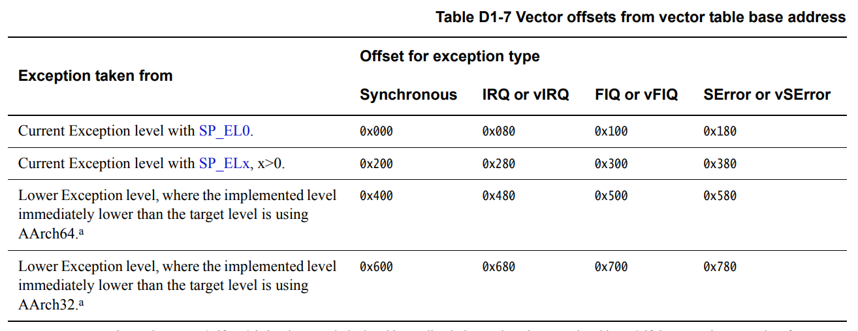
Exceptions in ARM_v8
16 exception handlers

Slide 12

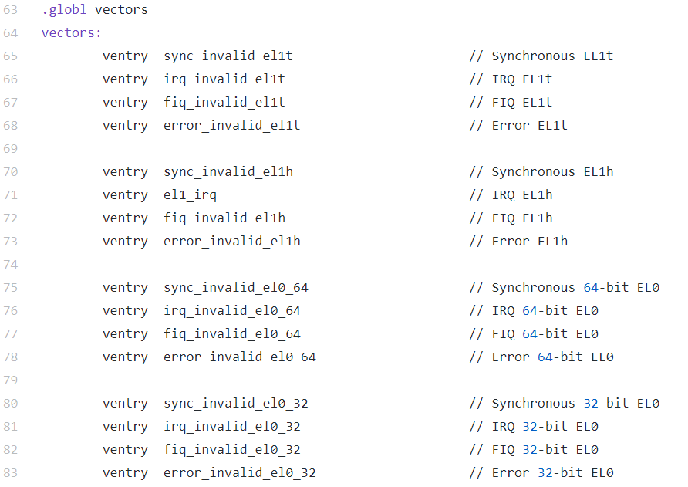
Implementation
Interrupt vector table
Each offset is 0x080 = 2^7

Slide 13
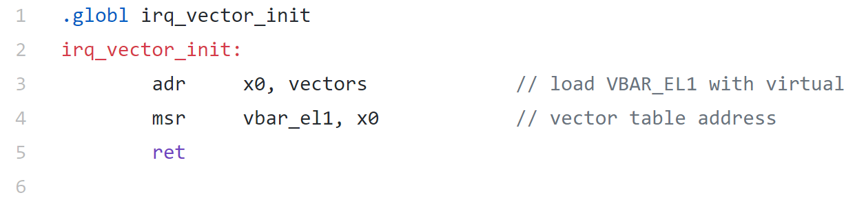
Implementation
Point to vector table

Slide 14
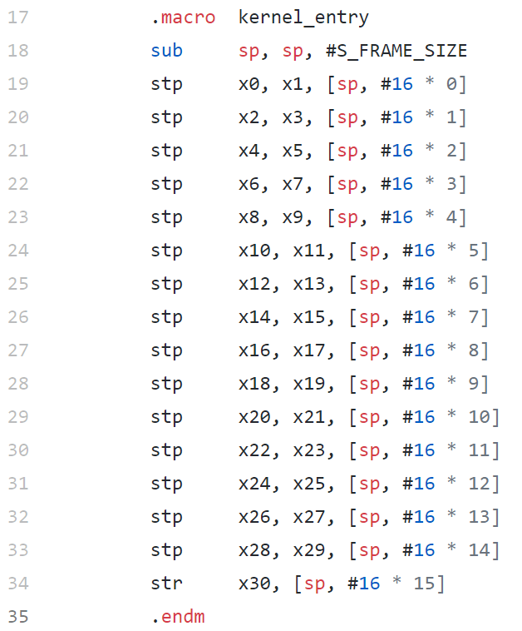
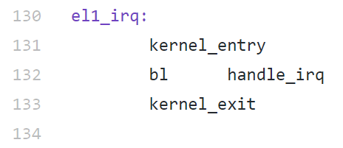
Implementation
Maintain a stack
Store all current regs. before going to ISR
Pop stack after finishing ISR

Slide 15
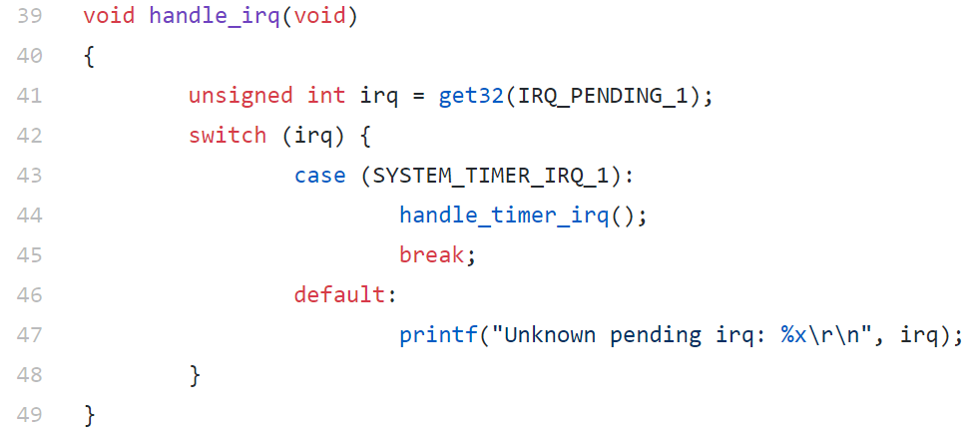
Implementation
ISR

Slide 16
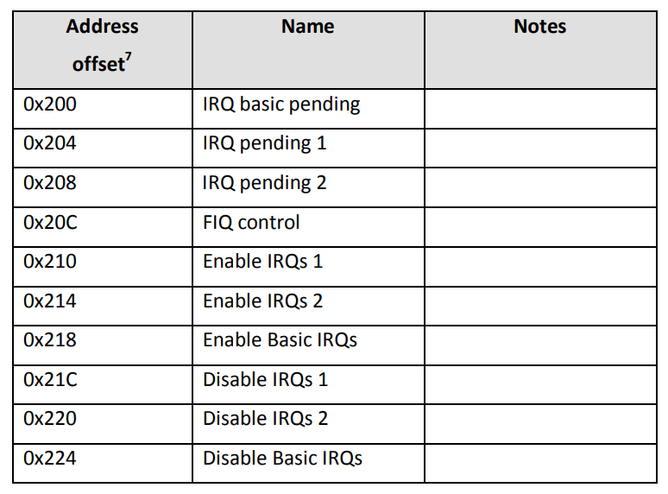
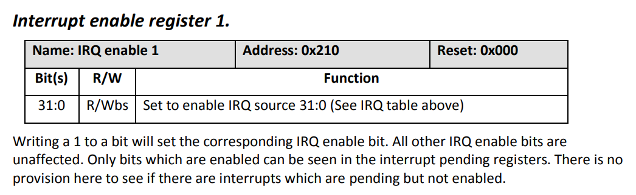
Implementation
Enable IRQ interrupt

Slide 17
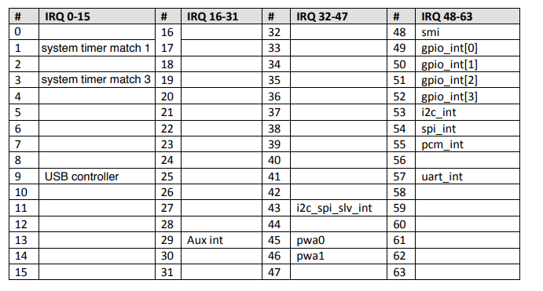
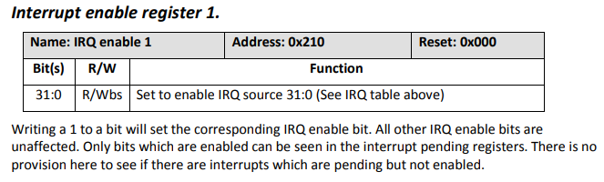
Implementation
Enable timer interrupt
Notes:
我們只能只用timer 1 & 3

Slide 18
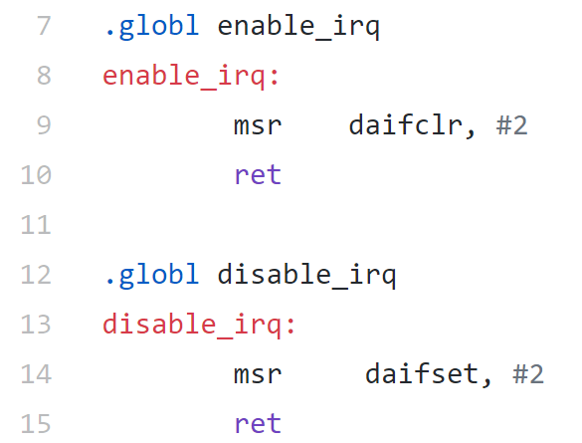
Implementation
Masking/unmasking interrupts
D : Mask debug exceptions
A : Masks SErrors
I : Masks IRQs
F : Masks FIQs

Slide 19
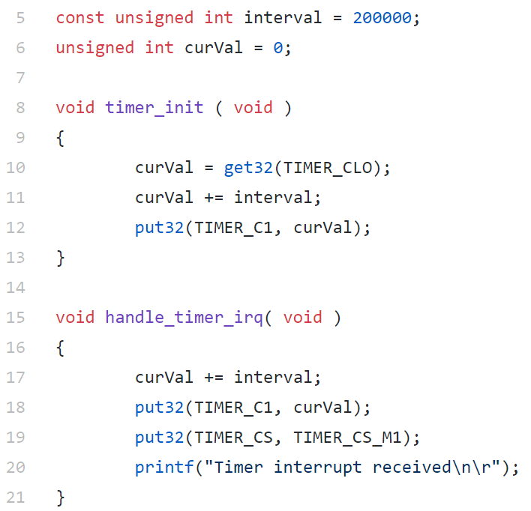
Implementation
Timer init & handle

Slide 20
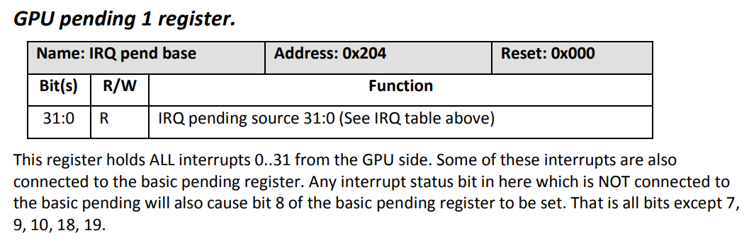
Implementation
When interrupt occurs , the IRQ pending bit will be set.
Check which interrupt occurred
IRQ

Slide 21
Practice time

Slide 22
Homework
Using two timers to control LEDs
Timer 1
LEDs blinks one after one (一個接著一個閃爍)
Timer 3
LEDs full light up and down (全部一起亮,全部一起暗)
The two timers should have obvious difference of time interval

